Slide 1
Probability and statistics 12-Null Hypothesis Significance Testing (NHST)
상명대학교 휴먼지능정보공학과

Slide 2
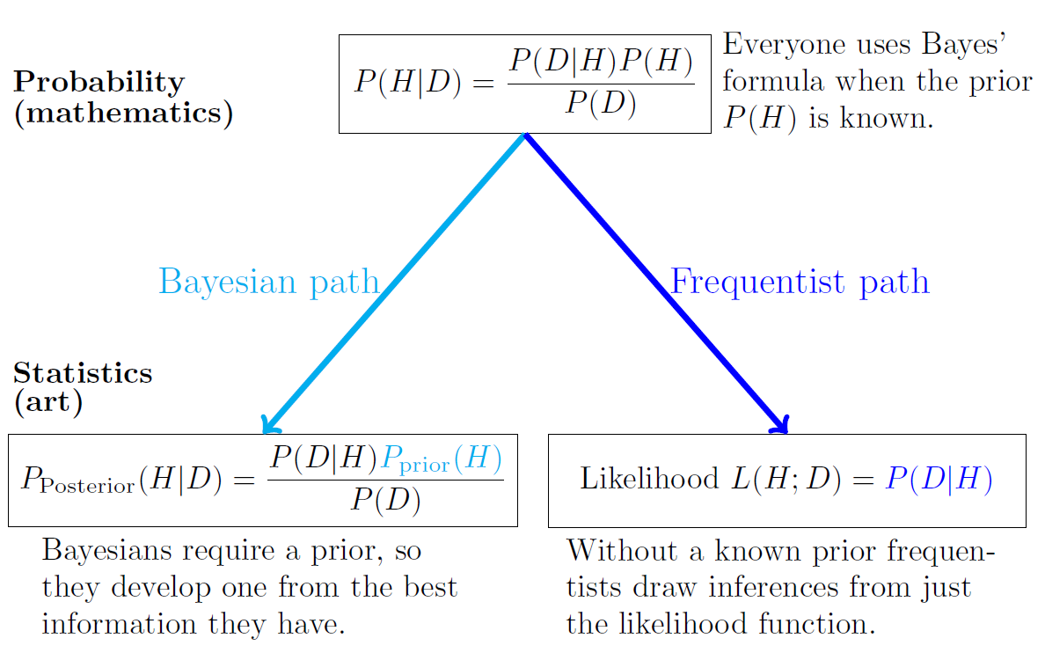
Difference between Bayesian & Frequentist

Slide 3
NHST Example
Suppose you want to decide whether a coin is fair. If you toss it 100 times and get 85 heads, would you think the coin is likely to be unfair?
What about 60 heads? Or 55 heads?
85 heads is strong evidence that the coin is unfair
55 heads can not be an evidence.
60 heads is less clear.
NHST is a frequentist approach to thinking quantitatively about these questions.

Slide 4
Statistical inference
Statistical inference is the act of generalizing from sample (the data) to a larger phenomenon (the population) with calculated degree of certainty.
We were introduced the important form of inference: estimation.
The second form of inference: null hypothesis significance tests (NHST), or “hypothesis testing” for short.

Slide 5
NHST
The computations done here all involve the likelihood function. There are two main differences between what we’ll do here and Bayesian updating.
1. The evidence of the data will be considered purely through the likelihood function, P(D|H). It will not be weighted by our prior beliefs, P(H).
2. We will need a notion of ‘extreme data’, e.g. 85 out of 100 heads in a coin toss.

Slide 6
NHST terminologies
H₀: the null hypothesis. This is the default assumption for the model generating the data.
H_{A}: the alternative hypothesis. If we reject the null hypothesis we accept this alternative as the best explanation for the data.
X: the test statistic. We compute this from the data.
Null distribution: the probability distribution of X assuming H₀.
Rejection region: if X is in the rejection region we reject H₀ in favor of H_{A}.
Non rejection region: the complement to the rejection region. If X is in this region we do not reject H₀. Note that we say ‘do not reject’ rather than ‘accept’ because usually the best we can say is that the data does not support rejecting H₀.

Slide 7
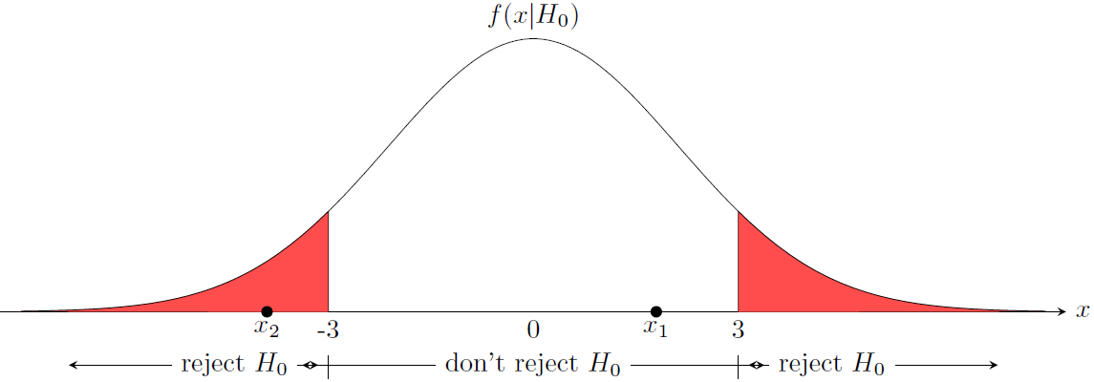
NHST ingredients
Null hypothesis: H₀
Alternative hypothesis: H_{A}
Test statistic: x
Rejection region: reject H₀ in favor of H_{A} if x is in this region
p(x|H₀) or f(x|H₀): null distribution

Slide 8
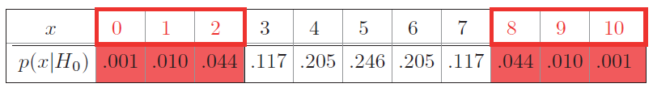
Choosing rejection regions
Coin with probability of heads θ.
Test statistic x = the number of heads in 10 tosses.
H₀: ‘the coin is fair’, i.e. θ =0.5
H_{A}: ‘the coin is biased, i.e. θ in not 0.5
Null distribution ~ Binomial(10, 0.5):
Let us set the Rejection region:

Slide 9
Choosing rejection regions
If we get 3 heads in 10 tosses, then the test statistic is in the non-rejection region.
The data ‘does not support rejecting the null hypothesis’.
Even if we got 5 heads, we would not claim that the data proves the null hypothesis is true.
“You can never prove the null hypothesis.”
How to choose a rejection region?

Slide 10
Question
If we have a fair coin, what is the probability that we decide incorrectly that it is unfair?
Rejection region:
Hint: P(reject|H₀)

Slide 11
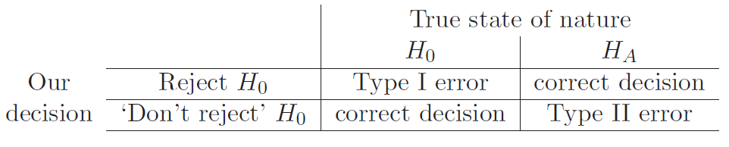
Types of error
Type I: false rejection of H₀
Type II: false non-rejection of H₀

Slide 12
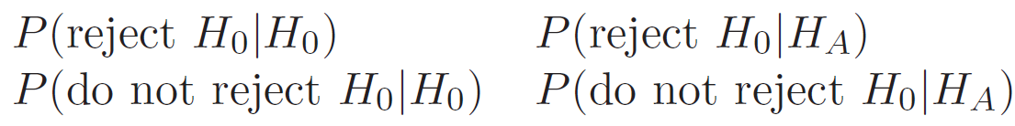
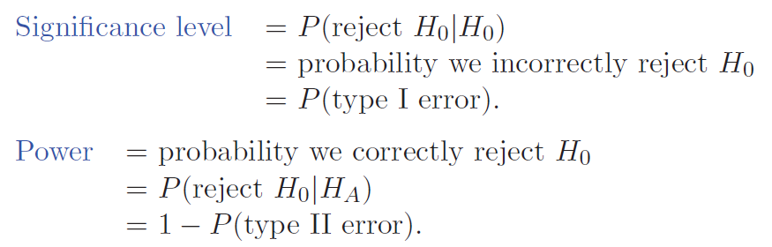
Significance level and power

Slide 13
Significance level and power
Ideally, a hypothesis test should have a small significance level (near 0) and a large power (near 1).
Think of H₀ as the hypothesis ‘nothing noteworthy is going on’, i.e. ‘the coin is fair’, ‘the treatment is no better than placebo’ etc. And think of H_{A} as the opposite: ‘something interesting is happening’.
Then power is the probability of detecting something interesting when it’s present; and significance level is the probability of mistakenly claiming something interesting has occurred.

Slide 14
Question
Coin with probability of heads θ.
Test statistic x = the number of heads in 10 tosses.
H₀: ‘the coin is fair’, i.e. θ =0.5
H_{A}: ‘the coin is biased, i.e. θ in not 0.5
Rejection range:
What is the Significance level of this test?
What is the Power of this test?

